Slide 1

CRC Cards
By James Moran
Notes:
1st Slide: Hello and welcome to this presentation on CRC Cards. I, James Moran, will be giving this presentation, let’s begin.

Slide 2
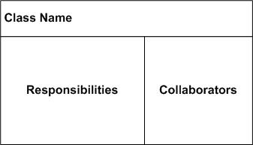
What are CRC Cards?
CRC: Class Responsibility Collaborator cards
(Rebecca Wirfs-Brock, 2009)
(Scott W. Ambler, 2014)
Notes:
2nd Slide: First off, what are CRC Cards? They are Class Responsibility Collaborator Cards, where the class identifies a certain entity, component or service of the system, the responsibilities are what the class is to keep track of, or the actions it can perform and the collaborators, are other classes that are related to/derive from or responsible for, certain aspects of this class.

Slide 3
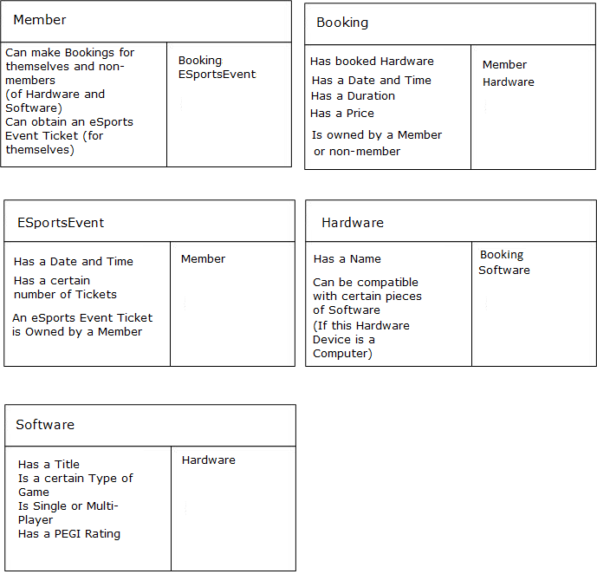
Example 1(First Pass)
Notes:
3rd Slide: Here is an example of their usage in the Game Café System. First, there is a Member class, whom can make bookings for themselves or non-members (for certain pieces of Hardware and any respective Software) and they can obtain eSports event tickets (but only for themselves). Second, comes the Booking class, which has a list of certain booked Hardware, a date and time, a duration, a price and is owned by a member (hence the collaborators of the Member and Booking classes). Third, comes the ESportsEvent class, which has a date and time, a certain number of tickets and is owned by a Member (but only Members, not Non-Members, as per the collaborators for the Member and ESportsEvent classes). Fourth, is the Hardware class, which has a name and can be compatible with certain pieces of software (if this Hardware device is a computer). This matches the Collaborators of the Booking and Software classes (as part of these class’s collaborators). Lastly, comes the Software class, which has a title, is a certain type of game, is a single or multi-player game and has a PEGI rating. It has Hardware as its only Collaborator, which matches to one of Hardware’s collaborators.

Slide 4
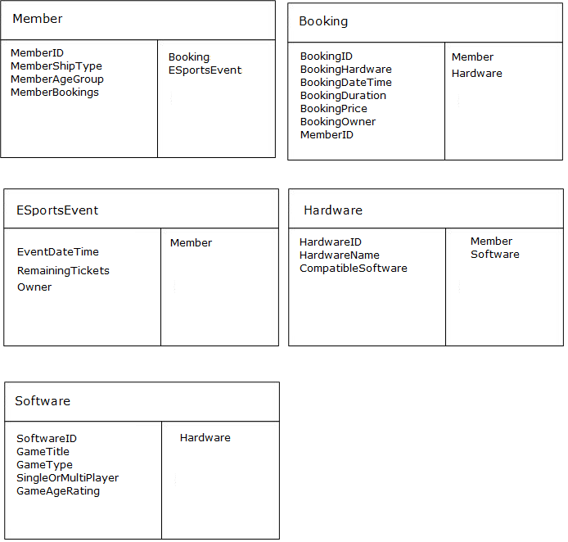
Example 2 (Second Pass)
Notes:
4th Slide: From the first pass, it is now possible to determine properties/methods of a class, now a general overview of their responsibilities has been provided. Starting with the Member class, there is a Member-ID (all classes for this project have an ID, as a primary-key to identify them in a Database-table), a Membership-Type, a Member-Age-Group and a list of Bookings by that Member. These details are required, as expressed in the first sprint’s set of User Stories. For the Booking class, there is a Booking-ID, a set of Hardware for that Booking, a date and time, a duration, a price, an owner and the Member-ID as a foreign key (to show that Members own Bookings).

Slide 5
The drawbacks of using CRC cards
Possibility of Low Cohesion and High coupling
Macho Classes
No clear role is defined
(Mohamed Fayad et al, 2003)

Slide 6
References
BROCK, R., R., 2009. CRC Cards: An Agile Thinking Tool [Viewed on the 25/03/2018]. Available from:
http://www.informit.com/articles/article.aspx?p=1391208
SCOTT A., W., © 2003-2014. Class Responsibility Collaborator Card Base Layout [Digital Image] [Viewed on the 25/03/2018]. Available from: http://agilemodeling.com/artifacts/crcModel.htm (Figure 1. crcCardLayout.jpg)
FAYED, M., HAMZA, H. and SANCHEZ, H., 2003. A Pattern for an Effective Class Responsibility Collaborator (CRC) Cards [viewed on the 10/02/2018]. Available from: http://sjsulug.engr.sjsu.edu/fayad/publications/conference/CRCPattern-Paper-IRI.pdf

